Slide 1
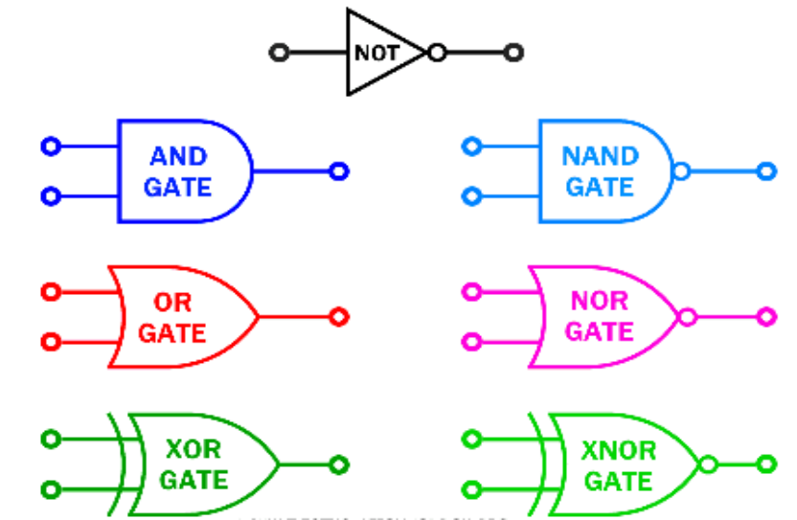
Unit 3.2 - Logic Gates & Logic Circuits
Prepared by: Koh Kian Hua

Slide 2
Objectives (Part 1)
After completing this unit, students should be able to:
Understand and define the functions of : NOT, AND, OR, NAND, NOR and XOR (EOR) gates.
Construct the truth table for each of the logic gates above.
Construct a logic circuit from a problem statement, logic expression and truth table.
Construct a truth table from a problem statement, a logic circuit and a logic expression.
Construct a logic expression from a problem statement, a logic circuit and a truth table.

Slide 3
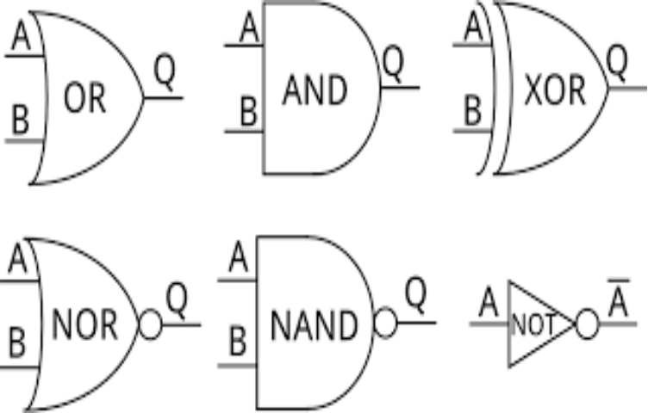
Logic Gates & Logic Circuits
Logic Gates
Electronic circuits in computers and controlling devices are made up of thousands of logic gates. Logic gates take binary inputs and produce a binary output.Based on this, logic gates are named as AND gate, OR gate, NOT gate etc.
Six different logic gates will be explained in this unit.

Slide 4
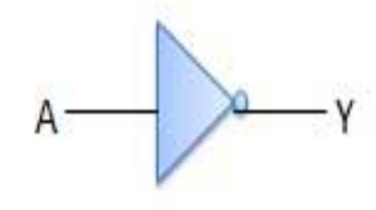

Logic Gates & Logic Circuits
Logic Gates
NOT Gate: NOT gate is also known as Inverter. It has one input A and one output Y.
Description
The output, X, is 1 if the input A is NOT 1
How to write this
Y = NOT A (logic notation)
Y = (Boolean algebra)
NOT Gate
Truth Table
Input (A) | Output (Y)
1 | 0
0 | 1

Slide 5
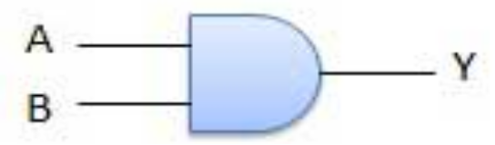

Logic Gates & Logic Circuits
Logic Gates
AND Gate: A circuit which performs an AND operation is shown in figure. It has n input (n >= 2) and one output.
Description
The output, X, is 1 if input A is 1 and input B is 1
How to write this
Y = A AND B (logic notation)
Y = (Boolean algebra)
AND Gate
Truth Table
Input |  | Output (Y)
A | B | Y
0 | 0 | 0
0 | 1 | 0
1 | 0 | 0
1 | 1 | 1

Slide 6
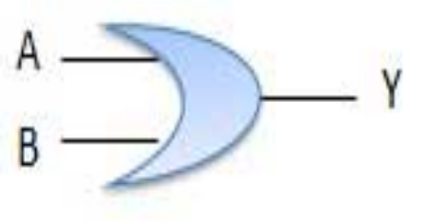
Logic Gates & Logic Circuits
Logic Gates
OR Gate: A circuit which performs an OR operation is shown in figure. It has n input (n >= 2) and one output.
Description
The output, Y, is 1 if input A is 1 or input B is 1
How to write this
Y = A OR B (logic notation)
Y = A + B (Boolean algebra)
OR Gate
Truth Table
Input |  | Output (Y)
A | B | Y
0 | 0 | 0
0 | 1 | 1
1 | 0 | 1
1 | 1 | 1

Slide 7


Logic Gates & Logic Circuits
Logic Gates
What do you think are the main differences between OR gate and AND gate ? List two of them

Slide 8
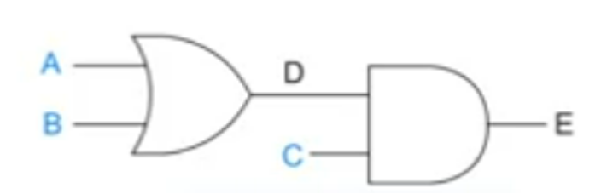
Logic Gates & Logic Circuits
Logic Gates
Combining Logic Gates: Logic Gates (eg: OR and AND gate and other gates) can be combined to form a new logic circuit and truth table.
Watch the video here: https://www.youtube.com/watch?v=rnZqSkpVtJo

Slide 9
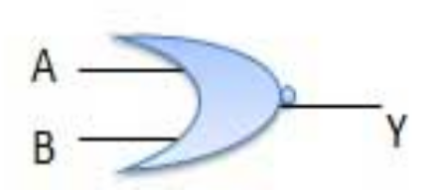

Logic Gates & Logic Circuits
Logic Gates
NOR Gate: A NOT-OR operation is known as NOR operation. It has n input (n >= 2) and one output.
Description
The output, Y, is 1 if:
input A is NOT 1 and input B is NOT 1
How to write this
Y = A NOR B (logic notation)
Y = (Boolean algebra)
NOR Gate
Truth Table
Input |  | Output (Y)
A | B | Y
0 | 0 | 1
0 | 1 | 0
1 | 0 | 0
1 | 1 | 0

Slide 10
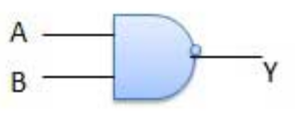

Logic Gates & Logic Circuits
Logic Gates
NAND Gate: A NOT-AND operation is known as NAND operation. It has n input (n >= 2) and one output.
Description
The output, Y, is 1 if:
input A is NOT 1 or input B is NOT 1
How to write this
Y = A NAND B (logic notation)
Y = (Boolean algebra)
NAND Gate
Truth Table
Input |  | Output (Y)
A | B | Y
0 | 0 | 1
0 | 1 | 1
1 | 0 | 1
1 | 1 | 0

Slide 11
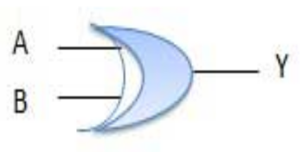


Logic Gates & Logic Circuits
Logic Gates
XOR Gate: The exclusive-OR gate is abbreviated as EX-OR gate or sometime as X-OR gate. It has n input (n >= 2) and one output.
Description
The output, X, is 1 if (input A is 1 AND input B
is NOT 1) OR (input A is NOT 1 AND input B
is 1)
How to write this
Y = A XOR B (logic notation)
Y = + (Boolean algebra)
XOR Gate
Truth Table
Input |  | Output (Y)
A | B | Y
0 | 0 | 0
0 | 1 | 1
1 | 0 | 1
1 | 1 | 0

Slide 12
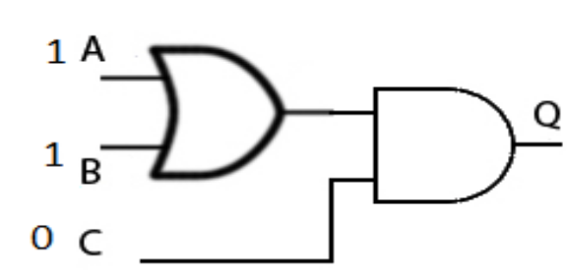
Logic Gates & Logic Circuits
Class Activity
1) What is the output at Q ?
2) Which logic gate can be represented by this truth table ?
Input A | Input B | Output
0 | 0 | 0
1 | 0 | 1
0 | 1 | 1
1 | 1 | 0

Slide 13
Logic Gates & Logic Circuits
Quiz on Logic Gates
Click on link below to complete the online quiz so that I can assess your understanding of the topic on logic gates.
URL: https://forms.gle/hMMjeSndcytqP4Ga7

Slide 14
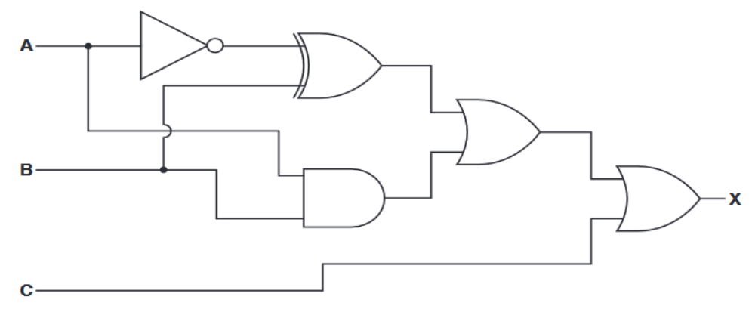
Logic Gates & Logic Circuits
Combinational Logic Circuits
It is possible to combine logic gates to perform a specific function such as controlling a robot.
When logic gates are combined, they formed a combinational logic circuit.
Example of a combinational logic circuit:

Slide 15
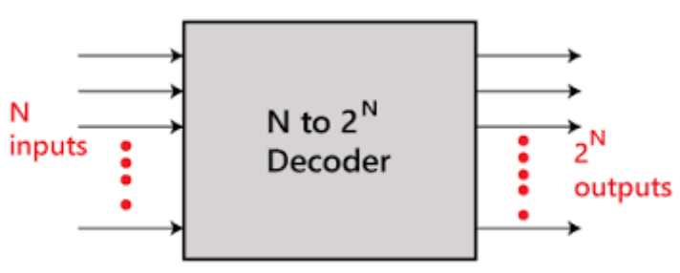
Logic Gates & Logic Circuits
Combinational Logic Circuits
Combinational logic circuits can be very simple or very complicated.
Combinational circuit can be implemented with only NAND and NOR gates as these are classed as “universal” gates.
An example of a combinational circuit is a decoder.
The decoder converts the binary code data (n-coded input) into a number of 2^{n} output lines

Slide 16
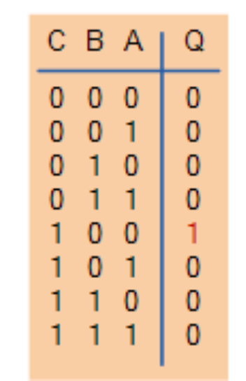
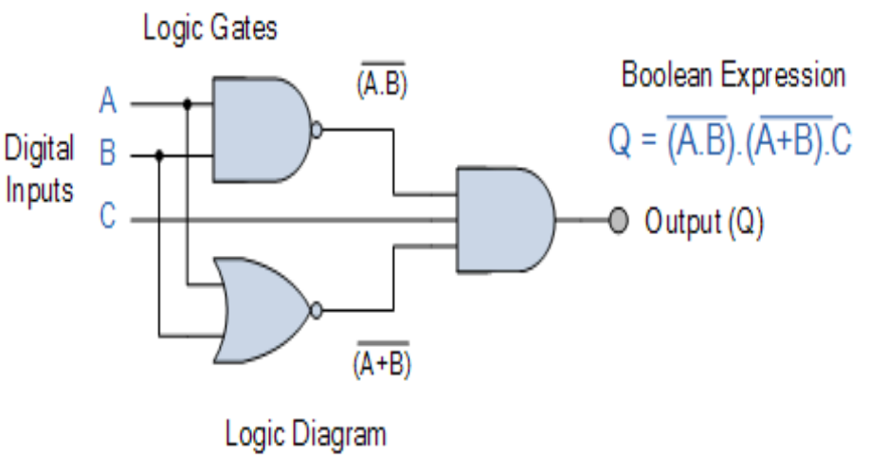
Logic Gates & Logic Circuits
Combinational Logic Circuits
Three main ways of specifying the function of a combinational logic circuit are:
  Boolean Algebra
  Truth Table
  Logic Diagram
Truth Table

Slide 17
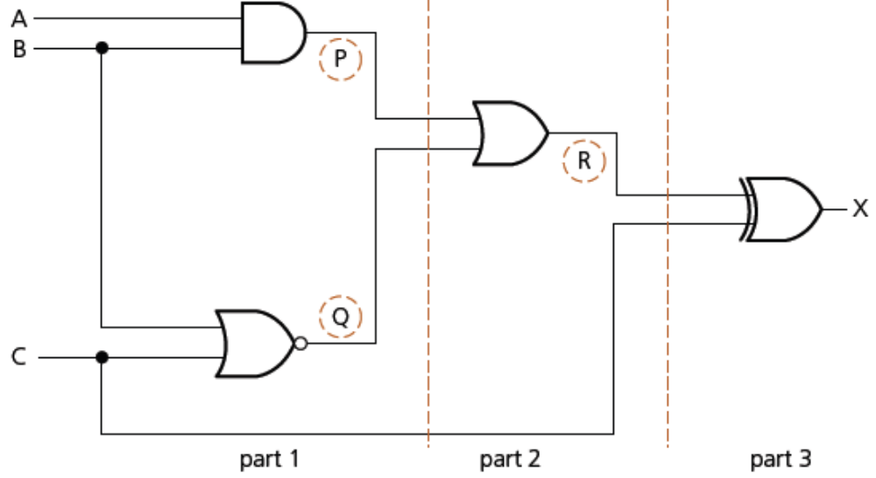
Logic Gates & Logic Circuits
Combinational Logic Circuits
Generate the truth table for the following logic circuit
In order to create the truth table, the circuit has to be split into 3 parts.

Slide 18
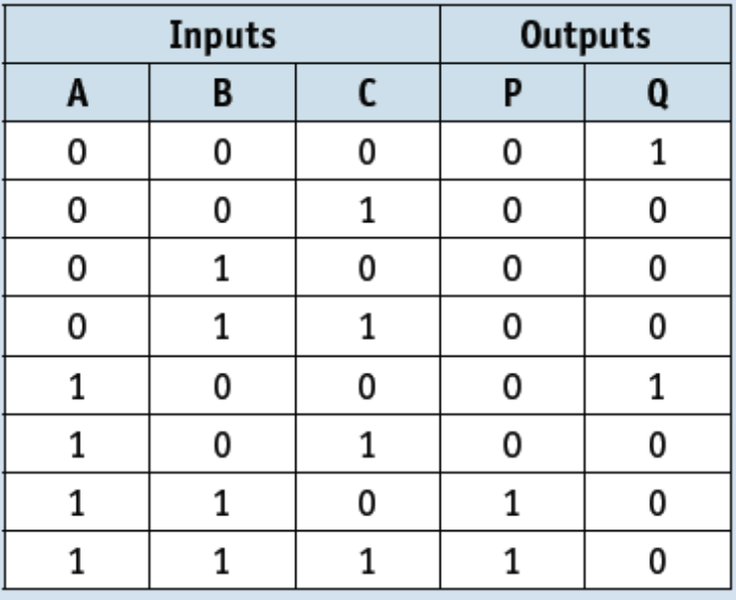
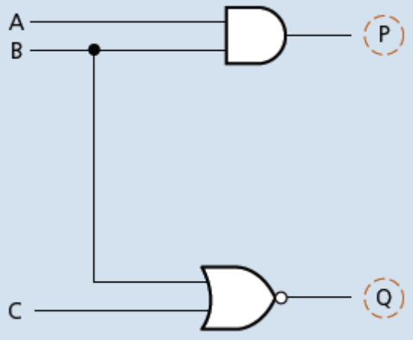
Logic Gates & Logic Circuits
Combinational Logic Circuits
Part 1:
Value of P is found from the AND gate where inputs are A and B.
Value of Q is found from the NOR gate where the inputs are B and C.
A truth table is produced as shown above

Slide 19
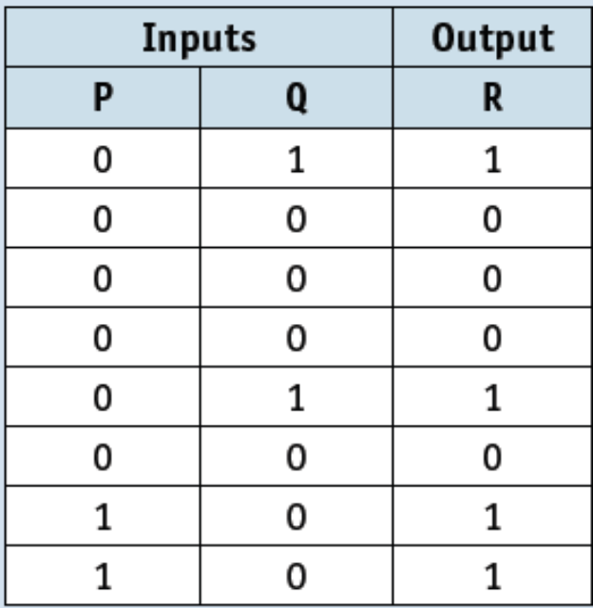
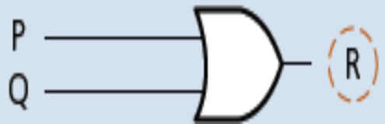
Logic Gates & Logic Circuits
Combinational Logic Circuits
Part 2:
The second part of the logic circuit has P and Q (derived from Part 1) as inputs and the intermediate output, R.
The truth table for the second part of the logic circuit is shown above.

Slide 20
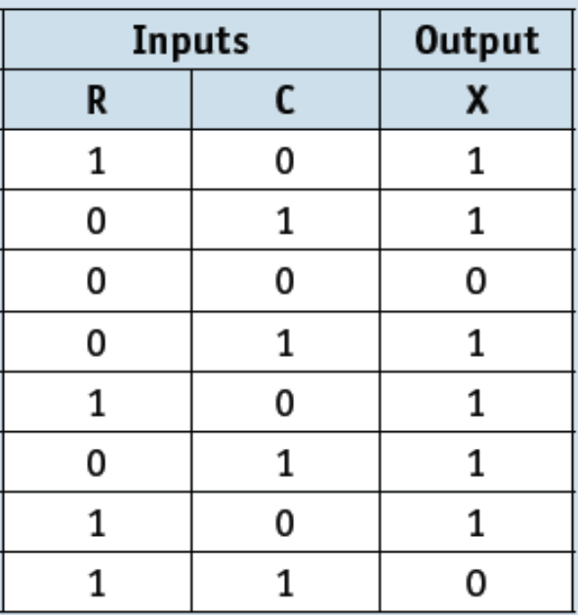
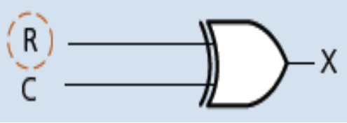
Logic Gates & Logic Circuits
Combinational Logic Circuits
Part 3:
The final part of the logic circuit has R and C as inputs and the final output, X.
This gives the third truth table shown above.

Slide 21
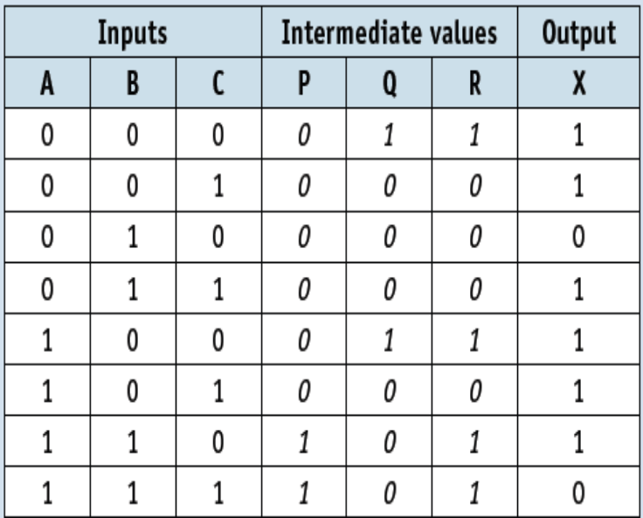
Logic Gates & Logic Circuits
Combinational Logic Circuits
Combine Part 1, Part 2 and Part 3
The final truth table for the original logic circuit is shown above.

Slide 22
Logic Gates & Logic Circuits
Combinational Logic Circuits
Generating Logic Circuit and Truth Table from a Problem Statement.
Example:
A safety system uses three inputs to a logic circuit. An alarm, X, sounds if input A represents ON and input B represents OFF, or if input B represents ON and input C represents OFF.
Produce a logic circuit and truth table to show the conditions which cause thevoutput X to be 1.
.

Slide 23


Logic Gates & Logic Circuits
Combinational Logic Circuits
A safety system uses three inputs to a logic circuit. An alarm, X, sounds if input A represents ON and input B represents OFF, or if input B represents ON and input C represents OFF.
Produce a logic circuit and truth table to show the above conditions which cause the output X to be 1.
Logic Statement
To solve the problem statement, we first write down the logic statement, assuming that ON = 1, and OFF = 0
X = 1 if:
.
This statement can also be written in Boolean algebra as: +
(A = 1 AND B = NOT 1)
This equates to A is ON and B is OFF
Part 1
OR
the two parts are
connected by the
OR gate
Part 2
(B = 1 AND
C = NOT 1)
This equates to B is ON AND C is OFF.
Part 3

Slide 24
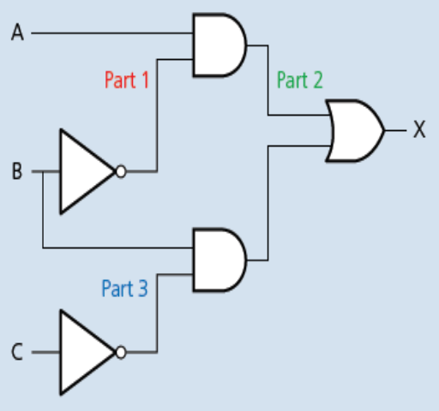
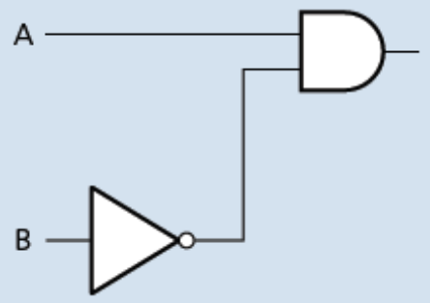
Logic Gates & Logic Circuits
Combinational Logic Circuits
Produce the logic gates for each part:
Part 1
Part 3
Part 2 (Combination of Part 1 and 3 using OR gate)

Slide 25
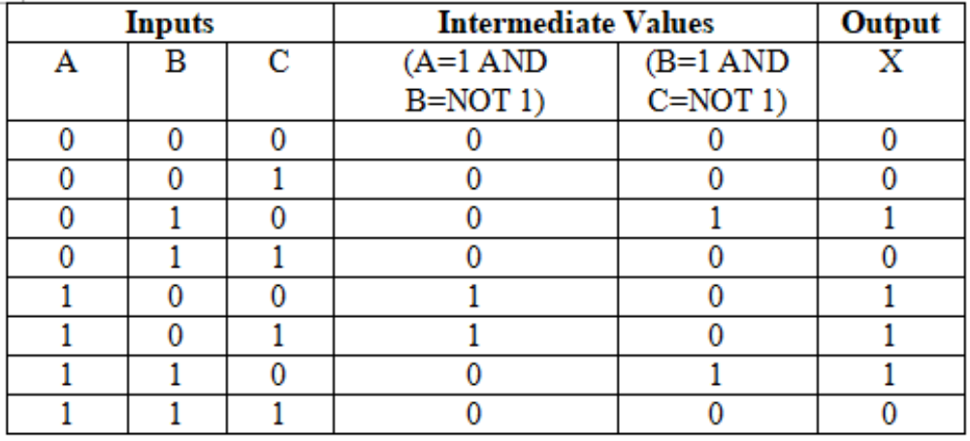
Logic Gates & Logic Circuits
Combinational Logic Circuits
Final Truth Table:

Slide 26
Logic Gates & Logic Circuits
Class Activity
Draw a logic circuit corresponding to this logic statement:
X = 1 if (A is NOT 1) OR ((B is 1 OR C is 1) AND (B is NOT 1 OR A is NOT 1))

